Slide 1

Semester Project – I | Final Submission (100%)
“HOUSE PRICE PREDICTION”
By
Khushi Anil Patil (251103033 & 104)
Chetana Vijay Kolhe (251104026 & 105)
Swara Jitendra Chaudhari(251108108 & 90)
Apeksha Rajendra Baviskar(251108082 & 68)
Under the Guidance of
Prof. Tushant A. Tayde
Department of Artificial Intelligence and Data Science
The Shirpur Education Society’s
R. C. Patel Institute of Technology, Shirpur - 425405.
[2026-27]

Slide 2

Outline
Project Title & Team Introduction
Domain Overview
Problem Statement
Literature Survey
Comparative Analysis
Proposed Methodology
Software and Hardware Requirements
Timeline / Gantt Chart
Project Completion Status & Results
Conclusion and Future Scope
References

Slide 3
Project Title & Team Introduction
Project Title: “House Price Prediction” – an ML-powered web application (Appraise) for instant property valuation
One-line pitch: enter a property's details and get an instant, data-driven price estimate in Indian Rupees
Team Members:
  Apeksha Rajendra Baviskar (251108082 & 68)
  Swara Jitendra Chaudhari (251108108 & 90)
  Khushi Anil Patil (251103033 & 104)
  Chetana Vijay Kolhe (251104026 & 105)
Guided by: Prof. Tushant. A .Tayde, Department of Artificial Intelligence and Data Science

Slide 4
Domain Overview
Domain: Machine Learning applied to Real Estate / PropTech
Property prices depend on many interacting factors — size, rooms, amenities, and location — which makes manual valuation slow and inconsistent
Regression-based ML models learn these relationships directly from data, producing fast and repeatable price estimates
The industry already relies on this idea — portals such as Zillow's “Zestimate” use ML-driven valuation as a core feature
This project applies the same principle at a focused scale: a self-contained estimator trained on structured property features

Slide 5
Problem Statement
Traditional home valuation relies on manual appraisal — slow, costly, and inconsistent across appraisers
Buyers and sellers often have no quick, independent reference price before they negotiate
Most property listings do not explain why a price is what it is, in terms of the property's own features
Need: a lightweight tool that takes standard property details (area, rooms, amenities) and returns an instant, consistent and data-driven price estimate

Slide 6
Literature Survey
Author(s) & Year | Technique(s) Used | Key Finding
Jing, Y. (2025) | Linear Regression, Decision Tree, Random Forest | Random Forest gave the best balance of accuracy and generalization on the California Housing dataset
Mahmoudi, Y. (2023) | GA + ANOVA feature selection with XGBoost, Random Forest, CatBoost, AdaBoost, GBDT | Optimized ensemble boosting models consistently outperformed single learners
Billah, M. A. M. (2025) | Linear/Ridge/Lasso Regression vs. Random Forest, XGBoost, LightGBM, CatBoost | CatBoost achieved the lowest error; boosted-tree models beat linear baselines
Comparative ML Study (2024) | Linear Regression, KNN, Random Forest, Gradient Boosting, Neural Network | Gradient Boosting reached the highest R² (0.92) on a Kaggle housing dataset; KNN performed worst
Fu, Y. (2024) | Linear Regression vs. Random Forest | Random Forest outperformed Linear Regression on MAE, RMSE, R², and MAPE

Slide 7
Research Gap & Motivation
Most published studies compare models offline on Kaggle-style CSVs — few package the winning model behind a usable interface
Tree-based ensembles (Random Forest, Gradient Boosting, XGBoost) repeatedly beat plain Linear Regression across studies — we chose Random Forest for its accuracy, robustness and low tuning effort
Many public housing datasets are region-specific and are not reusable end-to-end with a deployable pipeline
Gap addressed here: a complete pipeline — realistic data generation → trained Random Forest model → Flask REST API → browser-based UI — so the model is directly usable, not just benchmarked

Slide 8
Comparative Analysis
Aspect | Traditional Appraisal | Generic Portal Estimate | Proposed System (Appraise)
Speed | Days | Instant | Instant
Cost | Paid, per visit | Free | Free
Inputs considered | Full site visit | Location + broad stats | 12 property-specific fields
Output presented | Written valuation report | Single generic number | Instant price in Indian Rupees
Customizable per property | Yes (manual) | Limited | Yes, instantly from the browser

Slide 9
Proposed Methodology – System Architecture
Browser UI
User enters property
details
Flask API
POST
/api/predict
Preprocessing
One-hot encode +
pass-through
Trained Model
Random Forest
Regressor (.pkl)
JSON Response
estimate +
formatted price
The response travels back the same path: the UI reads the JSON and renders the estimated price live, with no page reload.

Slide 10
Proposed Methodology – Dataset & Model
12 input features: area, bedrooms, bathrooms, stories, parking (numeric); mainroad, guestroom, basement, hotwaterheating, airconditioning, prefarea (amenities); furnishingstatus (categorical)
Dataset: a 2,200-row synthetic-but-realistic dataset (fixed seed) with plausible price relationships — automatically replaced by a real Housing.csv of the same schema when supplied
Preprocessing: ColumnTransformer — numeric features passed through, six yes/no features and furnishingstatus one-hot encoded, all bundled inside one scikit-learn Pipeline
Model: RandomForestRegressor (n_estimators=400, max_depth=14, min_samples_leaf=2), trained on an 80/20 split (1,760 train / 440 test rows)
Final test performance: R² = 0.949 and MAE ≈ Rs. 3.55 lakh on the held-out test set

Slide 11
Proposed Methodology – Application Workflow
Backend: a Flask app (app.py) loads the trained pipeline (model.pkl) once on first use and exposes POST /api/predict and GET /api/health
Frontend: a plain HTML/CSS/JS estimator form — no build step; calls the API with the Fetch API and shows a live “Model status” indicator
Request flow: form submit → JSON payload → Flask validates inputs → model.predict() → JSON { price, formatted_price }
The UI renders the price in an animated appraisal stamp with no page reload; invalid input returns clear 400 errors

Slide 12
Software and Hardware Requirements
Software Requirements | Hardware Requirements
Python 3.10 or later | Standard PC / laptop (dual-core or better)
Flask ≥ 3.0 | 4 GB RAM minimum (8 GB recommended)
scikit-learn ≥ 1.4 | ≈200 MB free disk space
pandas ≥ 2.0, NumPy ≥ 1.26, joblib ≥ 1.3 | Internet connection (only for initial package install)
HTML5, CSS3, JavaScript (no build tools) | Any modern web browser
Code editor (e.g., VS Code) | —

Slide 13
Timeline / Gantt Chart – 100% Complete
Overall Progress
100% Complete
Phase & Deliverable
W1
W2
W3
W4
W5
W6
W7
W8
W9
Status
Dataset Preparation
100%
Completed
Model Training (Random Forest Regressor)
100%
Completed
Frontend–Backend Integration
100%
Completed
Price Prediction
100%
Completed
Testing
100%
Completed
UI Improvement
100%
Completed
Model Evaluation & Accuracy Testing
100%
Completed
Integration & Error Handling
100%
Completed
Final UI Improvements
100%
Completed
Documentation & Final Presentation
100%
Completed
Completed
Submission

Slide 14
Project Completion Status – 100% Completed
100%
Complete
Work Completed
Final Phase (30%)
Dataset Preparation: Load and preprocess the housing dataset; handle categorical values and prepare features.
Model Training: Train a Random Forest Regressor (400 trees) on the prepared dataset.
Frontend–Backend Integration: Connect the frontend to the Flask API to send house details and receive predicted prices.
Price Prediction: Display the estimated price (in Indian Rupees) from the entered features.
Testing: Test different inputs, check responses, and fix errors; R² = 0.949 on test data.
UI Improvement: Add house images, improve the layout, and make the website user-friendly.
Model Evaluation & Accuracy Testing – 10% (done)
Integration & Error Handling – 8% (done)
Final UI Improvements – 5% (done)
Documentation & Final Presentation – 7% (done)
10
Completed
0
In Progress
0
Pending
Final status: all modules are integrated and tested end-to-end; the model is evaluated (R² = 0.949, MAE ≈ Rs. 3.55 lakh); the project report and final presentation are complete and ready for submission.

Slide 15
Final Phase – 30% Work Completed
1. Model Evaluation and Accuracy Testing
2. Integration and Error Handling
3. Final UI Improvements
4. Documentation and Final Presentation
10% – Done
8% – Done
5% – Done
7% – Done
Evaluated on a held-out 20% test set (440 samples) using MAE and R².
Achieved R² = 0.949 and MAE ≈ Rs. 3.55 lakh.
Confirmed predicted prices are reasonable across the Rs. 17.5 lakh – 1.33 crore range.
Tested frontend ↔ Flask backend communication end-to-end.
Fixed prediction errors; invalid input now returns clear 400 messages.
Verified the price changes appropriately when inputs change.
Finished the blueprint-style design and responsive layout.
Added live house sketch and animated appraisal-stamp result.
Added client-side validation and plain-language error messages.
Completed the project report and final PPT.
Captured screenshots of the working website.
Documented architecture, dataset, algorithm, results and limitations.
Demonstration ready; source-code archive prepared.
Total work completed: 70% + 30% = 100%

Slide 16
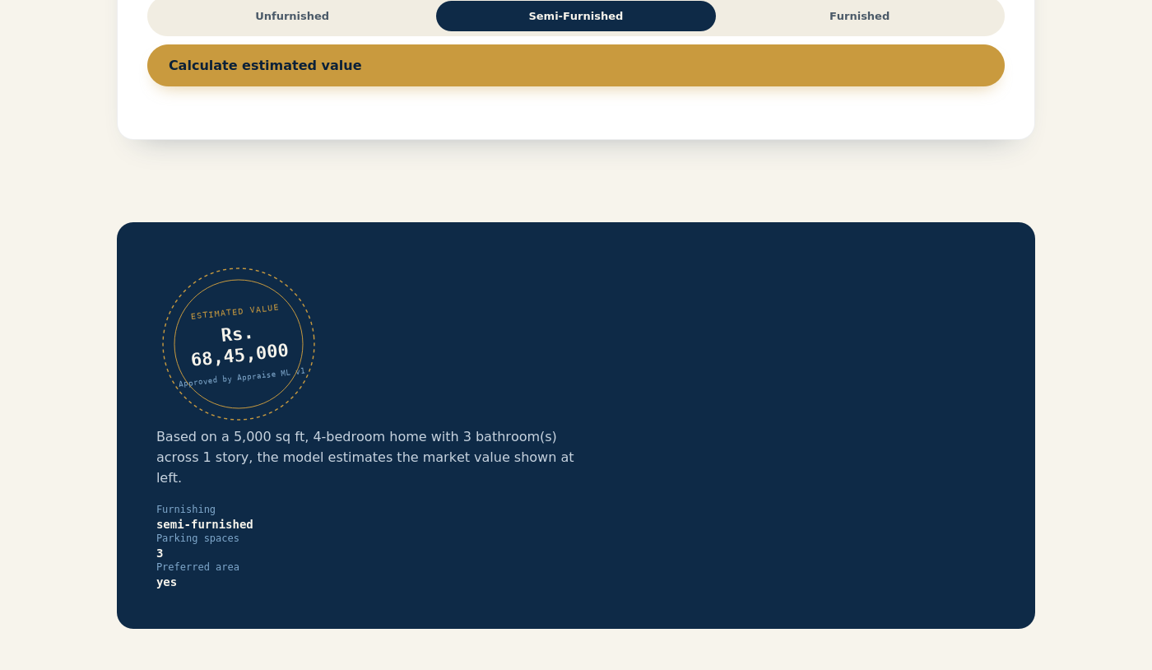
Results and Outcome Achieved
R² = 0.949
model fit on held-out test data (achieved)
Rs. 3.55 lakh
mean absolute error on the test set
12
property features considered
< 1 sec
response time (verified end-to-end)
Final Appraise UI: property details go in, an instant valuation in Indian Rupees comes out.

Slide 17
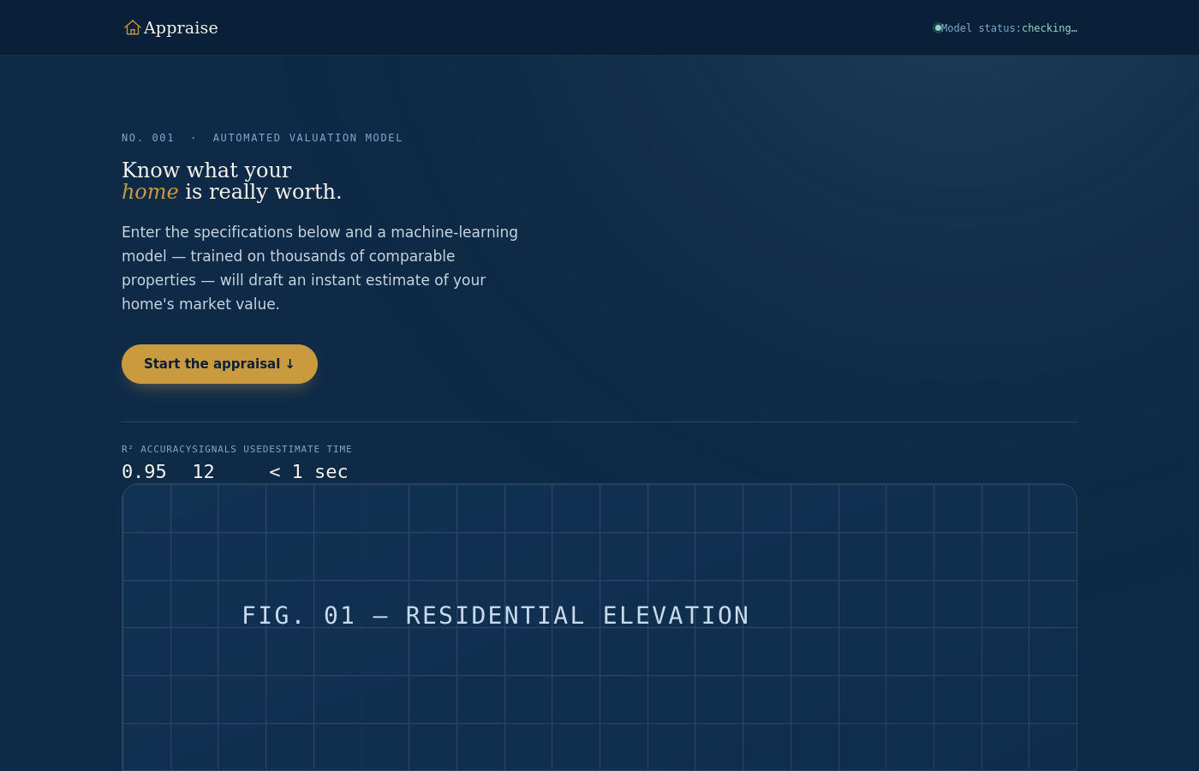
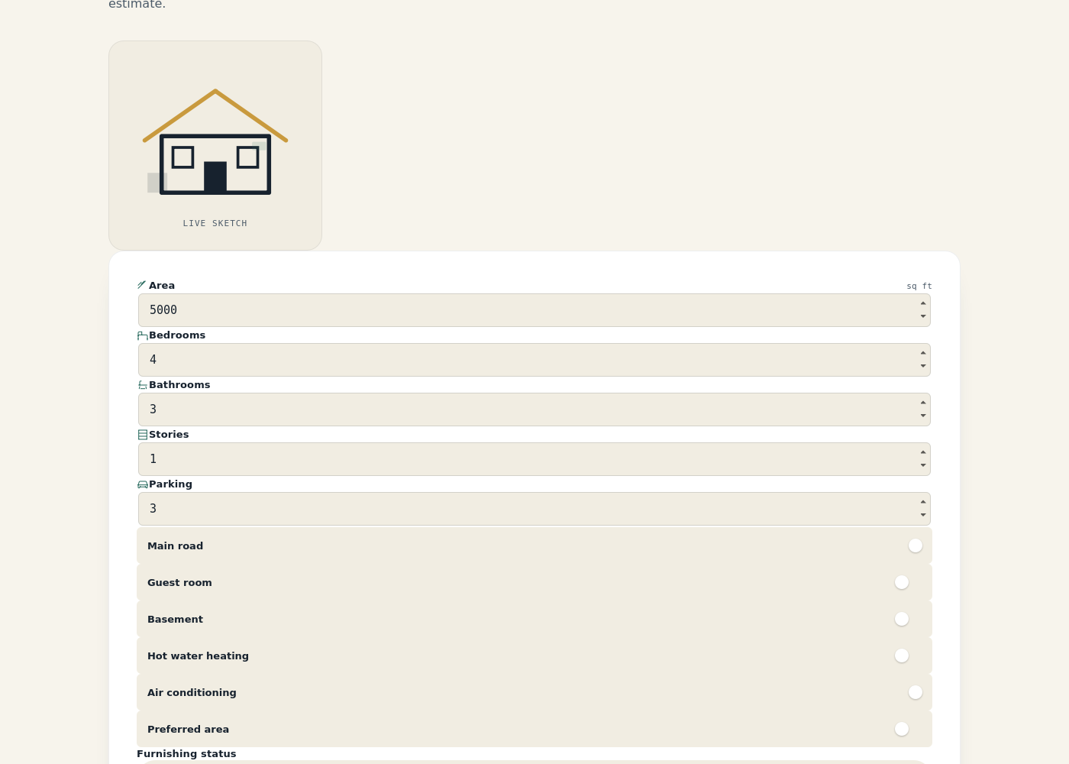
Working System – Final Application Screenshots
Landing page – R² = 0.95, 12 input signals, < 1 sec
Property input form with live house sketch

Slide 18
Conclusion and Future Scope
Conclusion
  Project is 100% complete: dataset, Random Forest pipeline, Flask REST API and the Appraise web UI are built, integrated and tested end-to-end
  The trained model achieves R² = 0.949 and MAE ≈ Rs. 3.55 lakh on the held-out test set — above the target of R² ≥ 0.90
  Predictions return in under a second, with input validation and clear error handling on both tiers; report and demonstration are ready
Future Scope
  Replace the synthetic dataset with real, region-specific listing data for production-grade accuracy
  Add explainability (e.g., SHAP values) and compare boosting models (XGBoost, LightGBM, CatBoost)
  Extend the model with location/geospatial features and time-based market trends
  Deploy to the cloud (WSGI server, Docker) with authentication and a history of past valuations

Slide 19
References
[1] Jing, Y. (2025). Comparing Machine Learning Models for House Price Prediction: Linear Regression, Decision Tree, and Random Forest. ITM Web of Conferences, 80. https://doi.org/10.1051/itmconf/20258001031
[2] Mahmoudi, Y. (2023). Machine Learning Approach for House Price Prediction. ResearchGate.
[3] Billah, M. A. M. (2025). Comparative Analysis of Machine Learning Models for House Price Prediction: From Linear Regression to Boosted Trees. Research Square, DOI: 10.21203/rs.3.rs-7840588/v1.
[4] Comparative Analysis of Machine Learning Models for House Price Prediction (2024). Atlantis Press. https://www.atlantis-press.com/proceedings/iciaai-25/126015268
[5] Fu, Y. (2024). A Comparative Study of House Price Prediction Using Linear Regression and Random Forest Models. ResearchGate.
[6] Pedregosa, F., et al. (2011). Scikit-learn: Machine Learning in Python. Journal of Machine Learning Research, 12, 2825–2830. https://jmlr.org/papers/v12/pedregosa11a.html
[7] Flask Documentation. https://flask.palletsprojects.com/
[8] Breiman, L. (2001). Random Forests. Machine Learning, 45(1), 5–32.

Slide 20


